Slide 1
R Intro
Haldre Rogers
EEOB590A Fall 2021

Slide 2
Folder structure for this class
EEOB590A-DataScienceR
CourseMaterials_preGit
Download today’s script (IntroToR part 1) to this folder
Assignments_preGit
Download week1 → AnalysisOutline.docx here
HaldreRogers_ResearchProject_preGit

Slide 3


R, RStudio, Git, GitHub
R, RStudio, Git, GitHub
Push
GitHub
commit
Pull

Slide 4
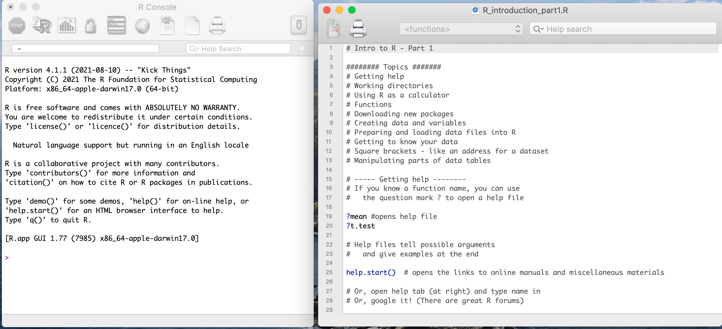

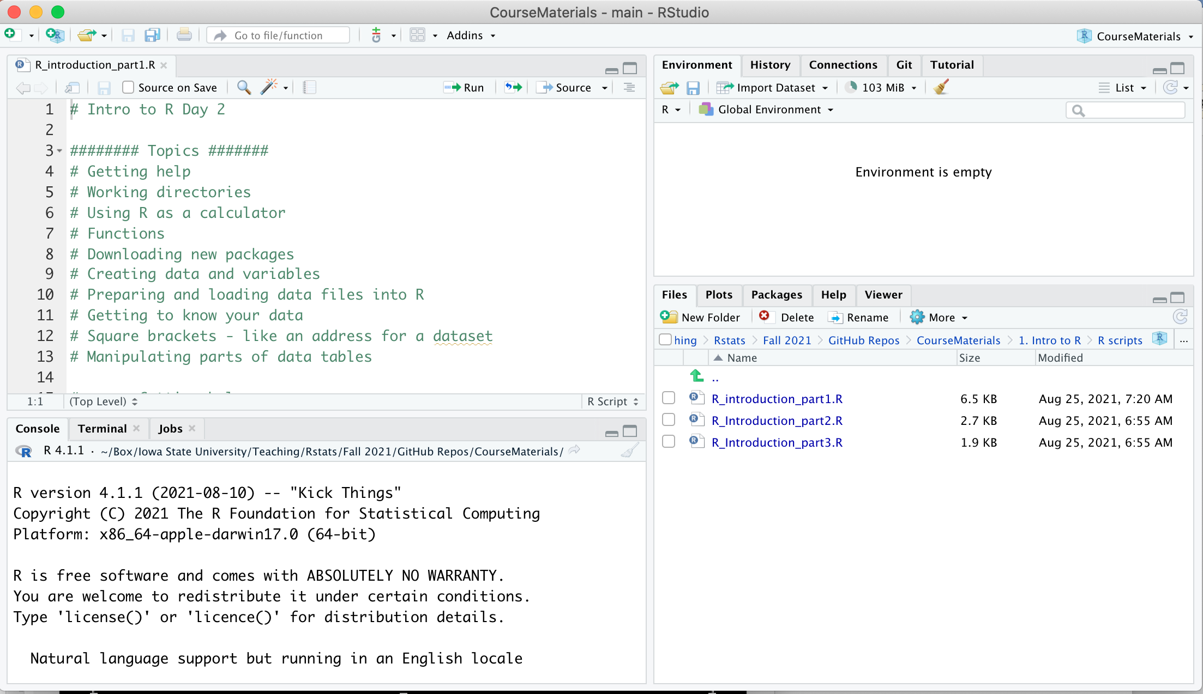
Starting an R session: R vs RStudio
Console
Workspace
Save your scripts from your workspace!
Workspace
Console

Slide 5
Open R and Rstudio to see the difference

Slide 6
Create & run a script in R Studio
Create a new script
File – New File -- R Script
Type something in script
Save script
R Studio will highlight syntax errors with a red squiggly line and a red X in the left side

Slide 7
Important R syntax
# is for notes – these are ignored in the console
<- or = are assignment operators
Whatever you want to name a function or a vector or a dataframe goes to the left of <- or =
c(“a”, “b”, “c”) is used for a string of objects
[row,column] = address for arrays or data frames

Slide 8
Play around in your R script. Type some notes, create a string of objects and name it something.

Slide 9
R functions
Function(arguments)
the order of arguments matters
Use ?functionname for help on any function in base R or in R packages
In RStudio, just press tab when in parentheses after the function name to see function options

Slide 10
Working directory
The working directory is a file path on your computer that sets the default location of any files you read into R, or save out of R.
You can only have one working directory at a time, and this is called the “current working directory”.
To set working directory: setwd(“fill_in_here")
To get your working directory: getwd()
To see what is in the working directory: dir()

Slide 11
Need help?
? And then whatever function you need help with
Use the help tab in lower right panel of Rstudio
help.start() - opens web browser with links to help
Google searches

Slide 13
Starting an R session: R Projects
A project is a working directory designated with a .RProj file.
Benefits of using R projects
When you open a project:
the working directory will automatically be set to the directory that the .RProj file is located in.
Any scripts you had open last time you were using the project will still be open.
Plays well with Git

Slide 14
Create an R Project
Name it “TestRProject_yourname”
In your File Explorer, move the file you downloaded from Git called “R_introduction_part1.R” into your .Rproj folder

Slide 16
Open Existing R Script
Open “Rintroduction_part1.R” by clicking on it in the console in the lower right part of RStudio
To run a line of code, click ”Run” button or press CTRL+Enter.
To run block of code, highlight it and click Run or CTRL+enter

Slide 17
Work through Parts 1, 2, and 3

Slide 19
R Packages
14,896 packages!!!!
Packages are extensions written by anyone for any purpose, usually loaded by:
In Rstudio, use the packages tab
OR use
install.packages(”packagename”), then
library(packagename)
Explore packages at the CRAN site:
http://cran.r-project.org/web/packages/
Inside-R package reference:
http://www.inside-r.org/packages

Slide 20
Other Intros to R:
Great (free) book to learn R: Hands-on programming with R by Garrett Grolemund. https://rstudio-education.github.io/hopr/index.html
http://www.stat.duke.edu/programs/gcc/ResourcesDocuments/RTutorial.pdf
http://www.cyclismo.org/tutorial/R/
http://www.r-tutor.com/r-introduction
Quick R: http://www.statmethods.net/
https://www.coursera.org/learn/r-programming
http://ecology.msu.montana.edu/labdsv/R/labs/R_ecology.html
http://www.bioconductor.org/help/course-materials/2011/CSAMA/Monday/Morning%20Talks/R_intro.pdf

